Slide 1

From Data to Decisions: Employee Attrition Analytics
BY GROUP 5
Kampally Sai Pavan Kumar
Raksha Gowda C
Bhuvnesh Kumar Udhwani
Prashanth Nayak Sabhavathula
Riya Dattaram Gaikar
Pavithra A
Neetu Ahlavadi

Slide 2
INTRODUCTION
Domain : HR Analytics
Project Name: Employee Attrition
Dataset Type: Excel Data
Dataset Size: 50k records each
Problem to Solve: Employee attrition poses significant challenges for organizations, leading to increased recruitment costs, loss of organizational knowledge, and reduced productivity.
This project aims to analyze HR datasets to identify key factors influencing employee attrition.
By examining metrics such as attrition rate, hourly wage patterns, departmental work-life balance, and promotion trends, the goal is to generate actionable insights that can help organizations improve retention strategies, enhance employee satisfaction, and reduce turnover.

Slide 3
DATA OVERVIEW
The dataset originally consisted of two data sheets: HR1 and HR2..
Each sheet contains one table:
HR1: Employee personal details, work information, and performance attributes.
HR2: Employee work history, salary details, and performance attributes.
Total Records: 50,000 employees
Attrition details:
Employees who left: 25,105
Employees remaining: 24,895
Timeline of Dataset (Years at Company)
Minimum years at company: 1 year
Maximum years at company: 40 years
Average years at company: 10.77 years

Slide 4
OBJECTIVE
The objective is to identify the key reasons behind employee attrition.
Analyze how demographic, financial, and career growth factors influence attrition.
Discover patterns in attrition by department, role, and income.
Compare attrition with working years and last promotion data.
Evaluate work-life balance and its link to employee turnover.
Suggest HR interventions to reduce unwanted attrition.
Deliver a data-driven foundation for employee retention strategies.

Slide 5
PROCESS
HR dataset imported into Excel and Power BI for cleaning and transformation.
Key columns like attrition, job role, department, salary, and promotions were used.
Unnecessary or duplicate rows were removed using Power Query.
Calculated KPIs include average attrition rate, tenure, and compensation.
Relationships were established between fields to perform comparative analysis.
Filters and slicers were used for detailed segmentation.
Visualizations like bar charts, scatter plots, and heatmaps were created.
Interpretation of each chart was based on business context and HR practices.

Slide 6


ANALYSIS
📊 Average Attrition Rate by Department
💸 Average Hourly Rate of Male Research Scientists
📉 Attrition Rate vs Monthly Income
⏳ Average Working Years by Department
⚖️ Job Role vs Work-Life Balance
📈 Attrition Rate vs Years Since Last Promotion

Slide 7
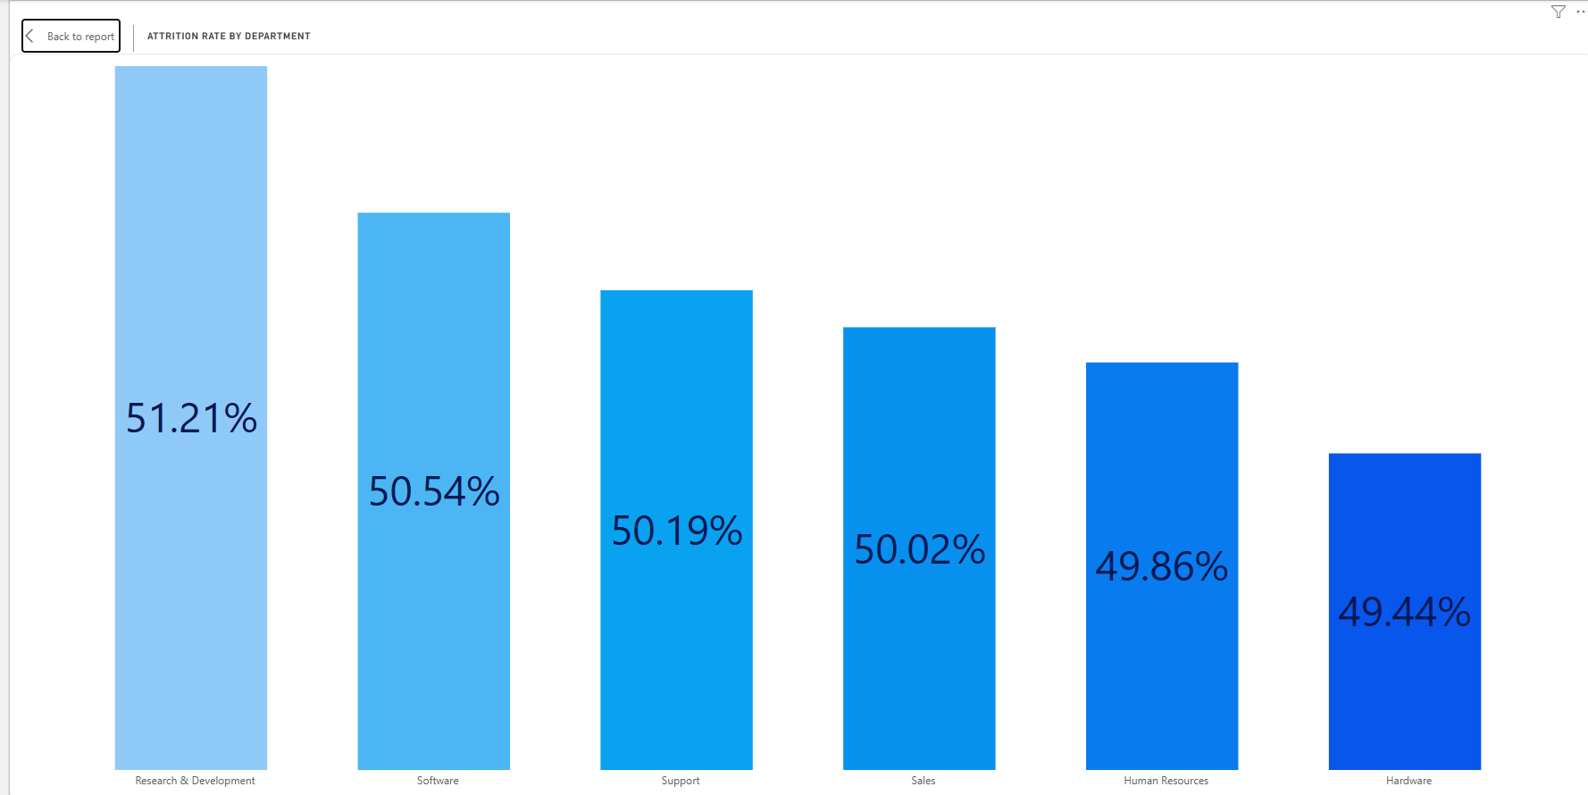
KPI 1 – Average Attrition Rate by Department
Attrition rate measures the percentage of employees who left the company.
Calculated using: (Employees Left ÷ Total Employees) per department.
Highest attrition was observed in R&D whereas lowest in Hardware
Indicates potential dissatisfaction or stress in certain departments.
Suggests the need for department-specific retention strategies.

Slide 8
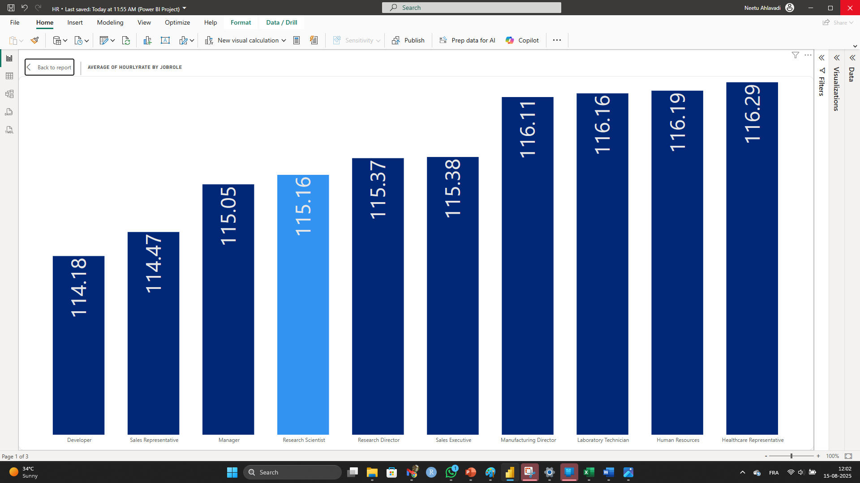
KPI 2 – Average Hourly Rate of Male Research Scientists
This KPI focuses on compensation of male Research Scientists.
Filtered data where Gender = Male and Job Role = Research Scientist.
Average hourly rate was found to be use actual value.
This helps evaluate if pay structure is fair and competitive.
Can influence attrition if underpaid compared to market standards.
Useful for salary benchmarking and HR audits.

Slide 9
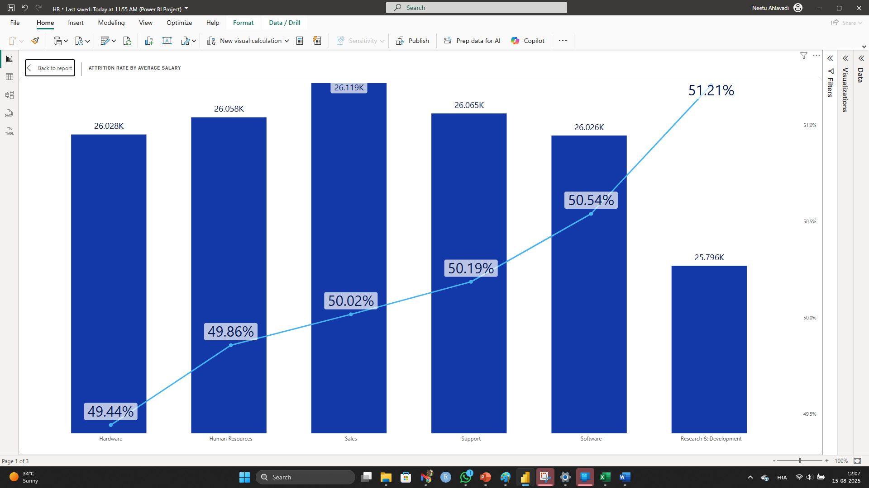
KPI 3 – Attrition Rate vs Monthly Income
This visual explores if income levels affect attrition trends.
Data was grouped into income bins and analyzed with Attrition Flag.
A clear pattern was found: lower income = higher attrition.
Middle-income ranges showed moderate attrition levels.
Higher salaries correlated with better employee retention.
Highlights the need for better compensation in lower bands.

Slide 10
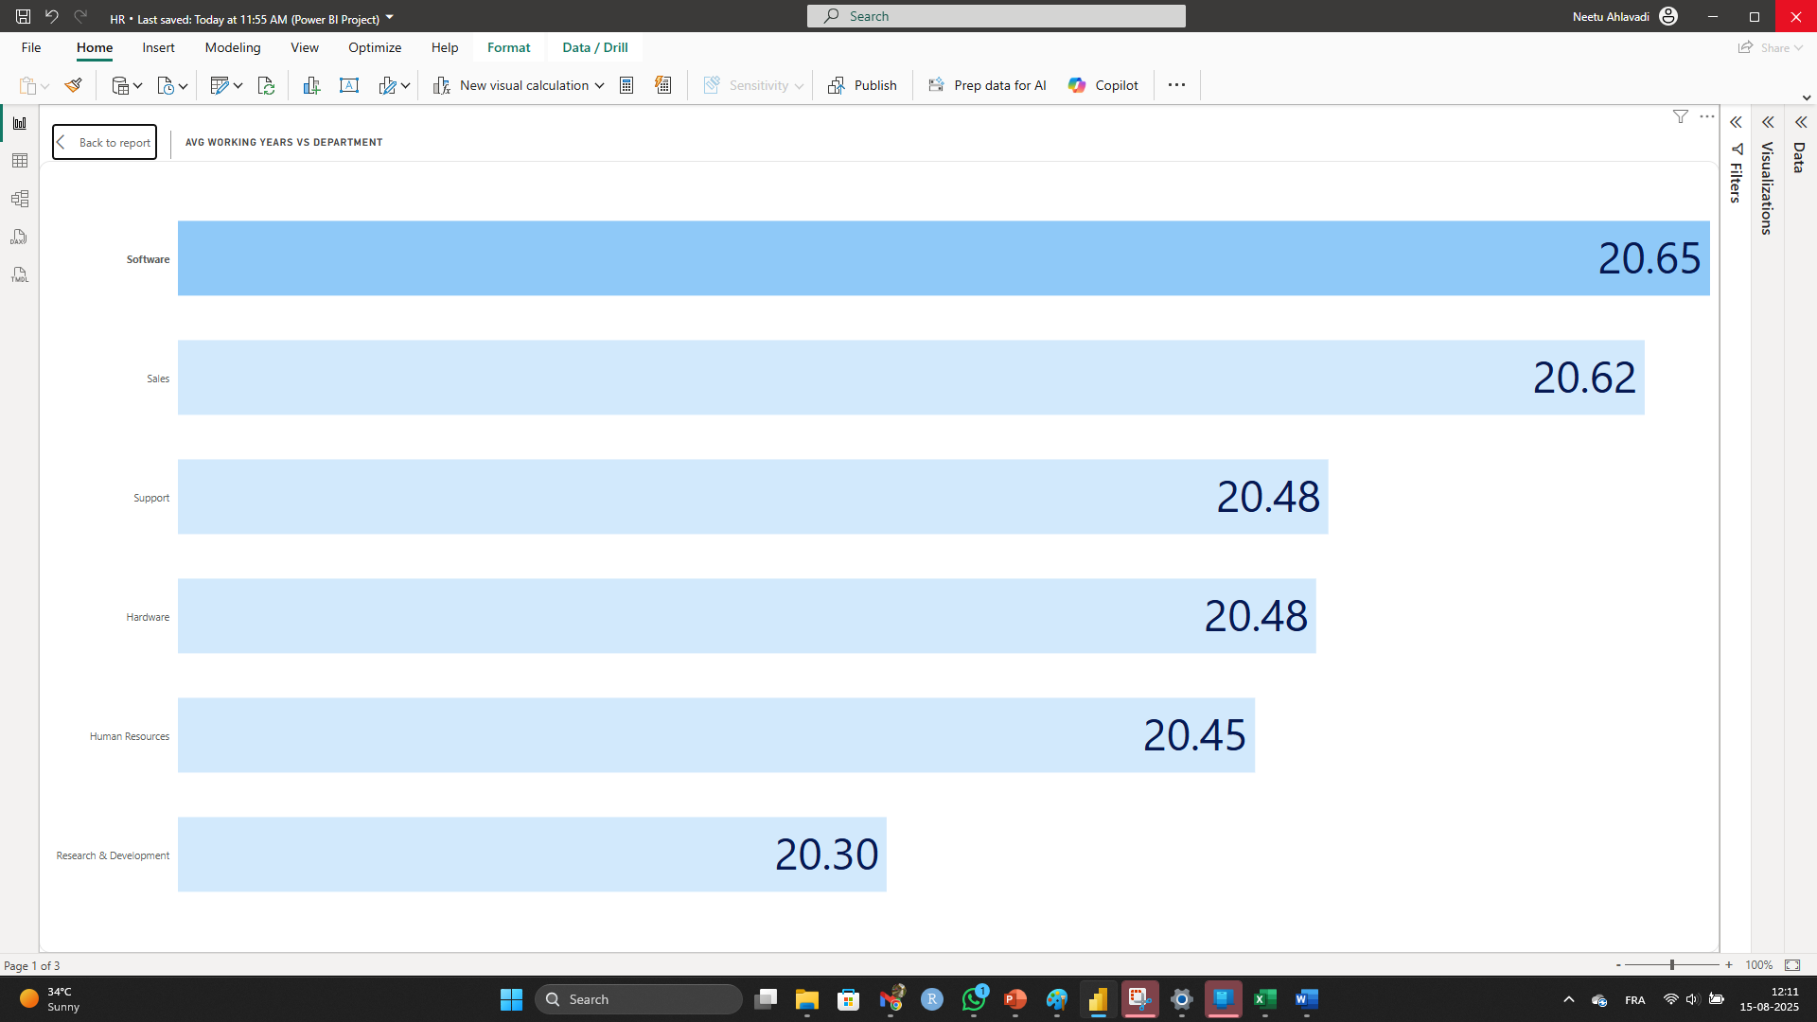
KPI 4 – Average Working Years per Department
Measures the average experience level of employees per department.
Departments Sales and Software had higher average working years.
Indicates more experienced and possibly stable workforce.
R&D and HR departments had fewer working years on average.
May reflect higher turnover or younger hires in those roles.
Useful for assessing department stability and retention plans.

Slide 11
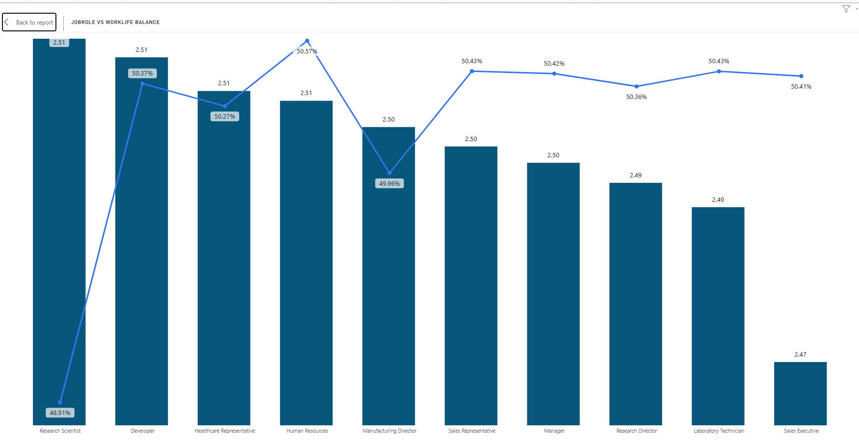
KPI 5 – Job Role vs Work-Life Balance
Evaluates employee work-life balance score (1 to 4) by job role.
Roles like Managers and Sales Executives had lower scores (~2).
Scientists, Developers, and HR Associates had better ratings.
Lower work-life balance links to higher burnout and attrition.
HR can use this to implement flexible work or wellness programs.
Provides a metric for improving employee satisfaction.

Slide 12
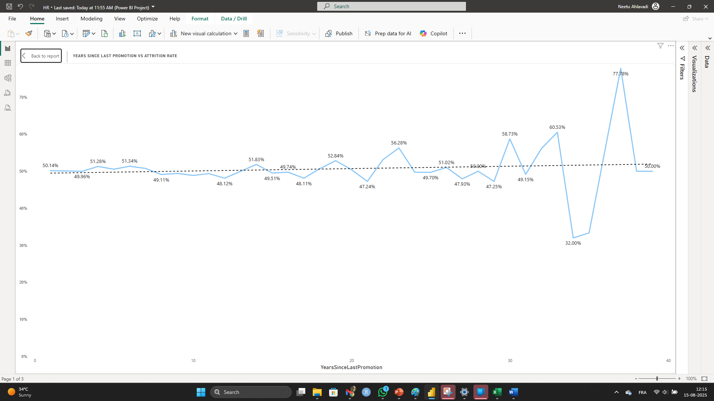
KPI 6 – Attrition vs Years Since Last Promotion
This KPI analyzes promotion gaps and their impact on attrition.
Grouped employees by YearsSinceLastPromotion and averaged Attrition Flag.
Found a rising trend: employees not promoted in 3+ years are more likely to leave.
Highlights lack of career growth as a key attrition driver.
Suggests HR must review and refresh promotion cycles.
Crucial insight for talent retention strategies.

Slide 13
KEY INSIGHTS
The attrition rate is 50.21%, indicating half of the workforce is leaving, which is a major retention challenge.
Research & Development (51.21%) and Software (50.54%) have the highest attrition rates, suggesting possible job stress or growth limitations in these departments.
Low-income and long promotion gaps strongly influence attrition.
Work-life balance is lowest among leadership roles.
R&D shows high stability due to better compensation and growth.
Promotions and salary adjustments can greatly reduce turnover.
Data reveals where HR should focus retention efforts.
These insights form the basis of our final recommendations.

Slide 14
RECOMMENDATIONS
Improve salary packages in low-income, high-attrition departments.
Revisit promotion policies—consider regular skill-based promotions.
Implement flexible work models to boost work-life balance.
Conduct exit interviews in high-turnover departments.
Offer leadership coaching and development for high-stress roles.
Use dashboards to continuously monitor attrition KPIs.
Build a data-driven HR culture for proactive decision-making.

Slide 15
CONCLUSION
Attrition is a multifactor issue-rooted in salary, role, and career growth.
Data reveals clear correlations that HR can act on immediately.
Improving retention improves productivity and reduces hiring costs.
This project helps HR move from reactive to predictive strategies.
Ongoing analytics can track success of interventions.

Slide 16
CHALLENGES AND LEARNINGS
CHALLENGES
Correlation Misinterpretation – High income or specific job roles seemed related to attrition, but required careful analysis to avoid false causation.
Visualization Clarity – Balancing detail with readability while keeping the dashboard user-friendly.
KEY LEARNINGS
Importance of Data Preprocessing – Clean, well-structured data drastically improves analysis accuracy.
Impact of Business Context – Salary alone is not a definitive predictor; other factors like job satisfaction and work-life balance matter.
Power of Data Binning – Grouping continuous values like Monthly Income into ranges made trends clearer.
Interactivity Enhances Insights – Slicers and filters empowered HR teams to explore specific departments, age groups, or roles.
Iterative Design – Building, testing, and refining visuals improved both the storytelling and usability of the dashboard.

Slide 17

Employee Attrition Dashboards -Key Metrics at a Glance

Slide 18
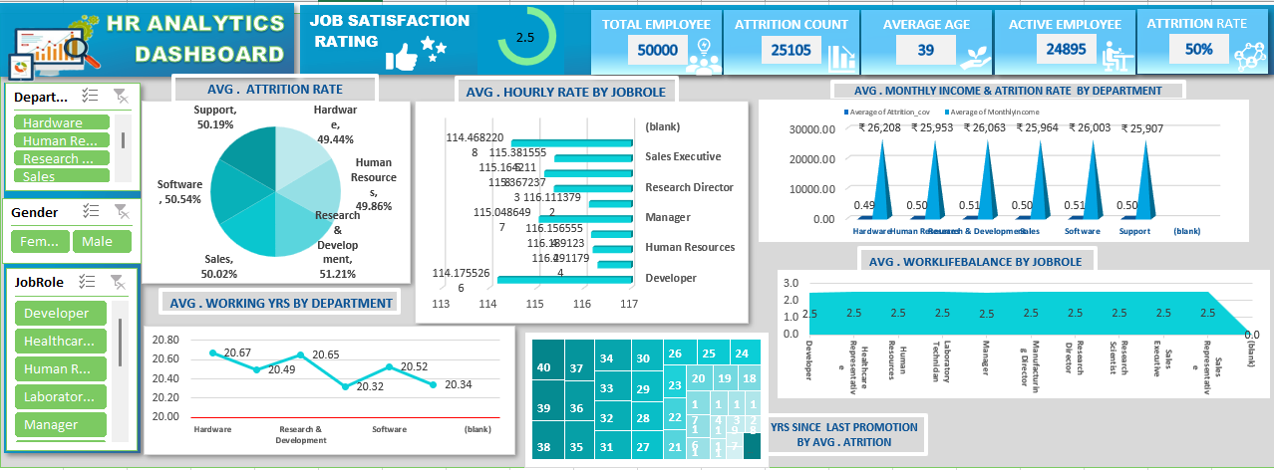
MS EXCEL DASHBOARD

Slide 19
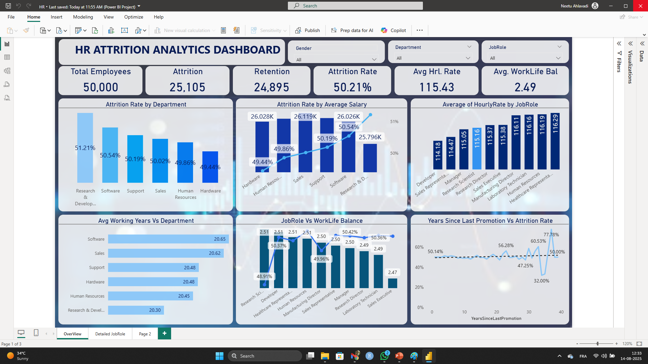
POWER BI DASHBOARD

Slide 20
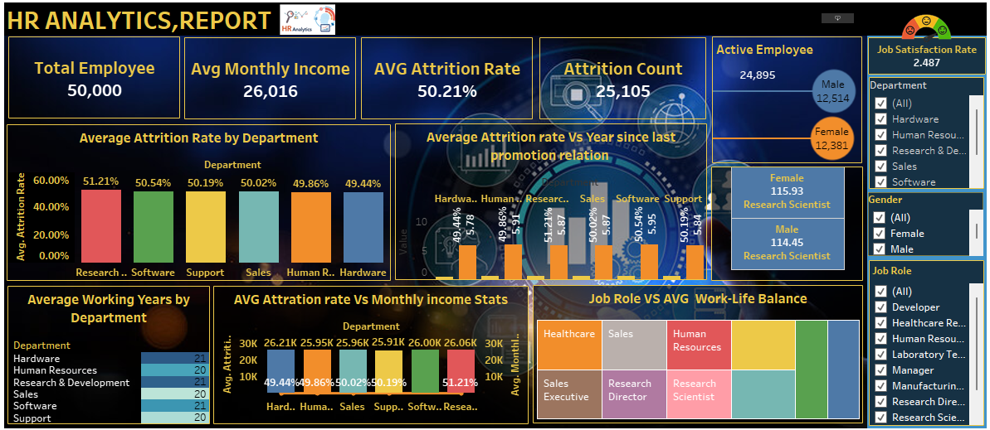
TABLEAU DASHBOARD

Slide 21
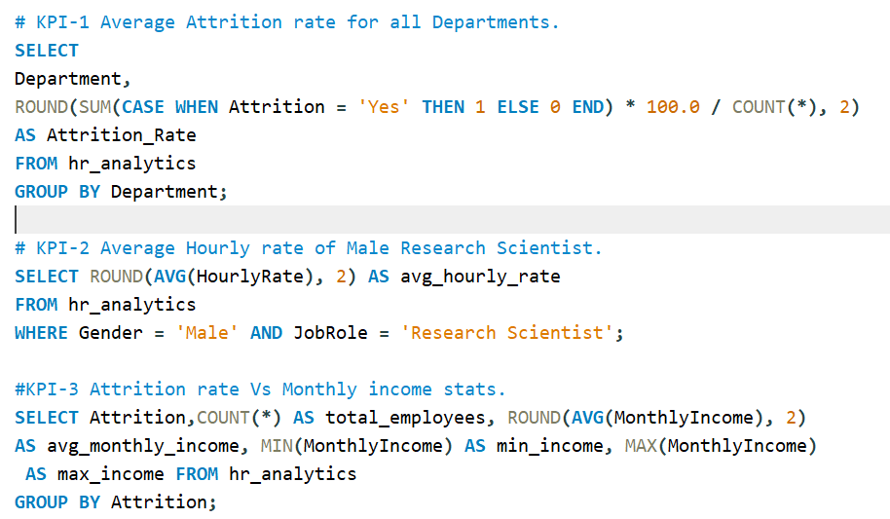
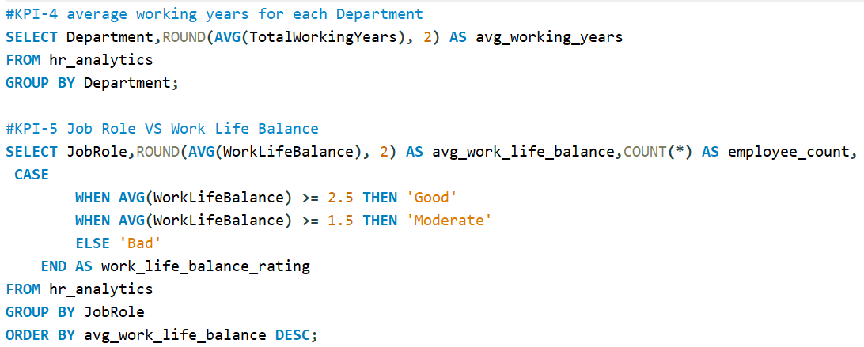
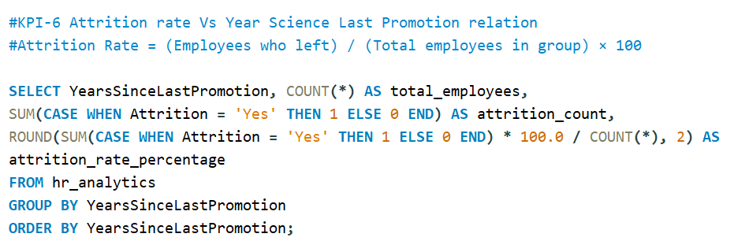
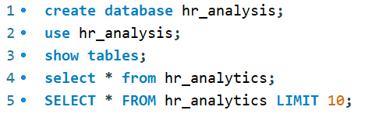
MYSQL

Slide 22


